Slide 1

ONLINE SERVICE MANAGEMENT SYSTEM
MIR KASIM ALI NAQVI
REG NO: 1713181033029
UNDER THE GUIDANCE OF
Prof. H.RIAZ AHAMED,M.C.A, M.Phil

Slide 2
INTRODUCTION
OSMS is India’s leading chain of multi-brand Electronics and Electrical service workshops offering wide array of services. We focus on enhancing your uses experience by offering world-class Electronic Appliances maintenance services. Our sole mission is “To provide Electronic Appliances care services to keep the devices fit and healthy and customers happy and smiling”. With well-equipped Electronic Appliances service centre and fully trained mechanics, we provide quality services with excellent packages that are designed to offer you great savings. Our state-of-art workshops are conveniently located in many cities across the country.
Today’s customers don’t just expect high quality and excellent service at a fair price — they demand it. Luckily, today we know far more about how to provide people with the experience they want. And it all begins with Online Service Management System

Slide 3
ABSTRACT
Online Service Management System is a project which aims in developing a, Online Application to maintain all the daily work of Service Centre .This project has many features which are generally not available in normal Online Service Management Systems like Product/Parts Records, Issue Customer Bill etc. It also has a facility of admin login through which the admin can monitor the whole system. This
System can be used to search for Assign Work, Add/Remove Technician, Add/Remove Products etc. The Admin after logging into his account can generate various reports such as Product Sell Report and Service/Work Report.
Overall this project of ours is being developed to help the Service Centre to maintain the Service Centre in the best way possible and also reduce the human efforts.

Slide 4
MODULES
HOME
SERVICES
REGISTRATION
CONTACT
LOGIN
USER PANEL –PROFILE - SUBMIT REQUEST - SERVICE STATUS-CHANGE PASSWORD – LOGOUT – ADMIN LOGIN
ADMIN-MODULE
DASHBOARD
WORK ORDER
REQUEST
TECHNICIAN
REQUESTER
SELL REPORT
WORK REPORT
CHANGE PASSWORD
LOGOT

Slide 5
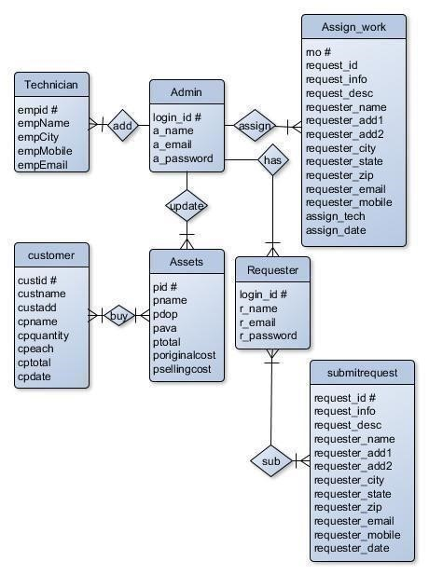
ER DIAGRAM

Slide 6
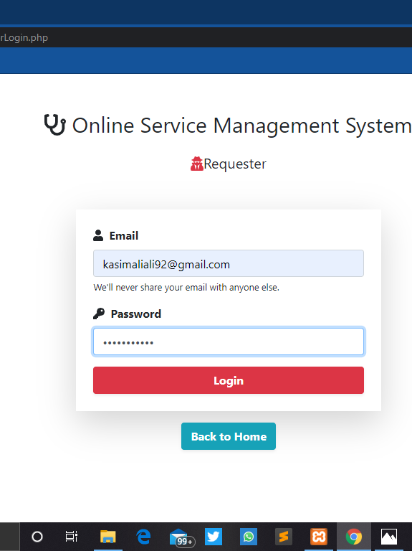
LOGIN PAGE
FORM LAYOUT
This is user login form. When an user clicks on this link a user login form will be appear where user can enter their email id and password for logging in to the user panel.

Slide 7
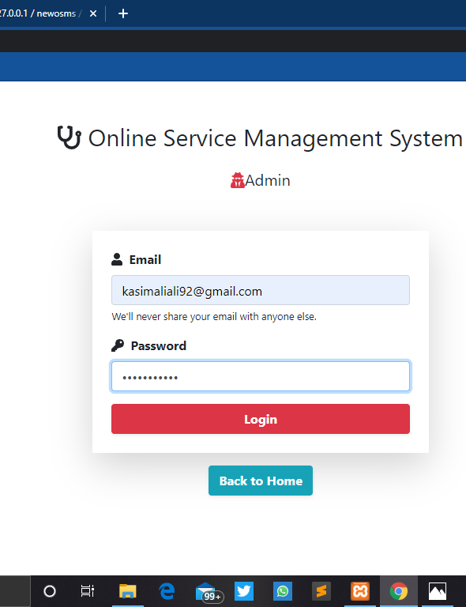
ADMIN LOGIN
This is Admin login form. When Admin clicks on this link an Admin login form will be appear where admin can enter their email id and password for logging in to the Admin panel

Slide 8
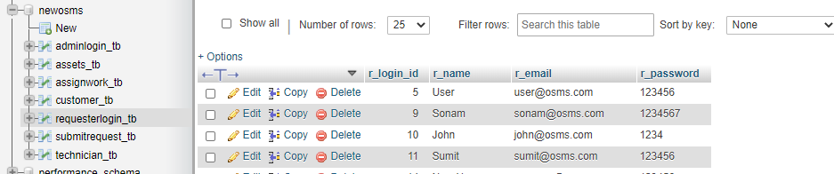
REQUESTER LOGIN TABLE
Attribute | Data Type | Description
r_login_id # | int | Stores login id (Automatically Generated)
r_name | varchar(60) | Stores Name
r_email | varchar(60) | StoreEmail
r_password | varchar(60) | Store Password

Slide 9
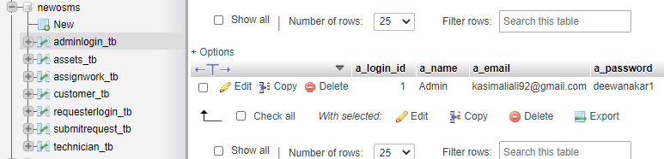
ADMIN LOGIN TABLE
z | Data Type | Description
a_login_id # | int | Stores login id (Automatically Generated)
a_name | varchar(60) | Stores Name
a_email | varchar(60) | StoreEmail
a_password | varchar(60) | Store Password

Slide 10
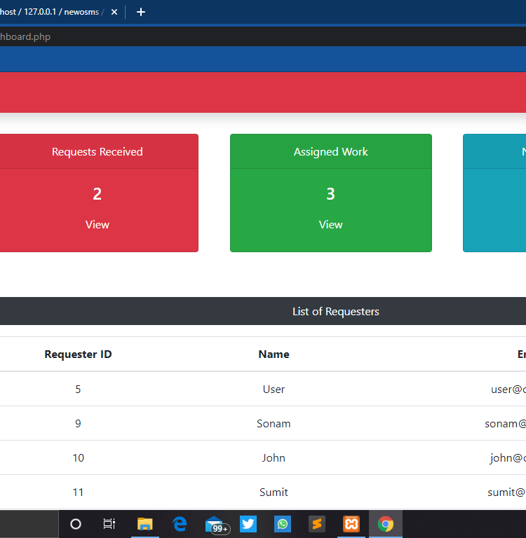
REDISTERED USER
DATA REPORTS
The main work is to accomplish in this module is to add, modify or remove Requesters/Users. This contains few sub modules through which works are performed

Slide 11
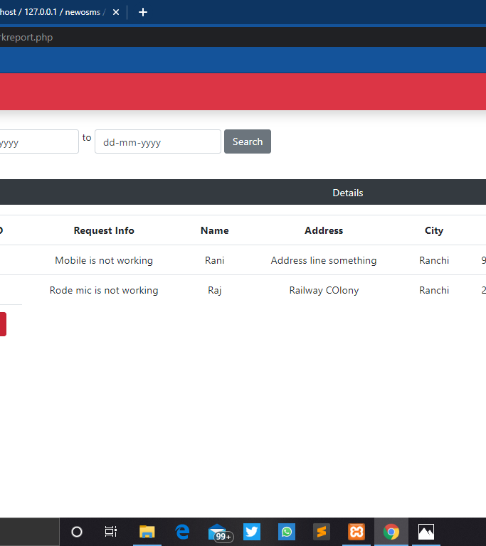
WORK REPORT
This module is used to view and print Work report.

Slide 12
CONCLUSION
The Online Service Management System has been computed successfully and was also tested successfully by taking "Test Cases". It is user friendly, and has required options, which can be utilized by the user to perform the desired operations.
The Software is developed using HTML, CSS, JS as front end and PHP, MySql as back end in windows environment. The goals that are achieved by the software are:
Simplification of the operations.
Less processing time and getting required information.
User friendly.
Portable and flexible for further enhancement.

Slide 13
FUTURE ENHANCEMENT
The various things can be made it simple and user friendly. As by increasing some of the coding we can improve it functionality. online payment system is yet not integrated to the system which can be featured in the near future. Till now it does not have the facility of back up the database. By as the next advancement we can make it able to bundle the backup facility so that one can perform operation based on previous records.
As the technology emerges, it is possible to upgrade the system and can be adaptable to desired environment.
Based on the future security issued, security can be improved using emerging technologies.

Slide 14
THANK YOU

